Slide 1
Wire Sculpture

Slide 2
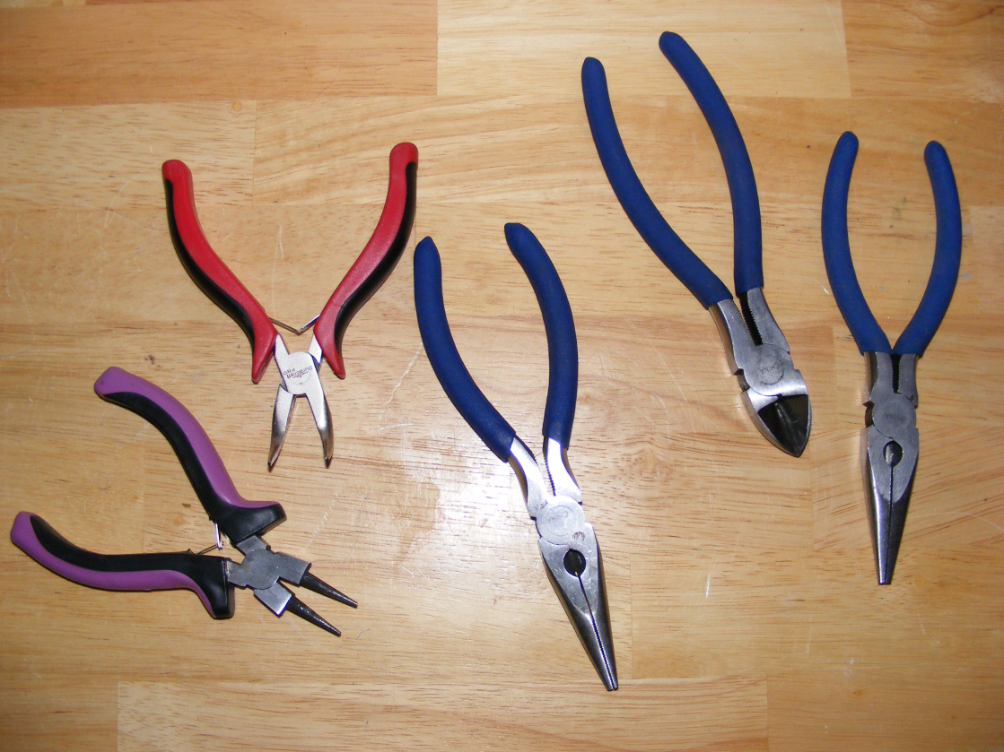
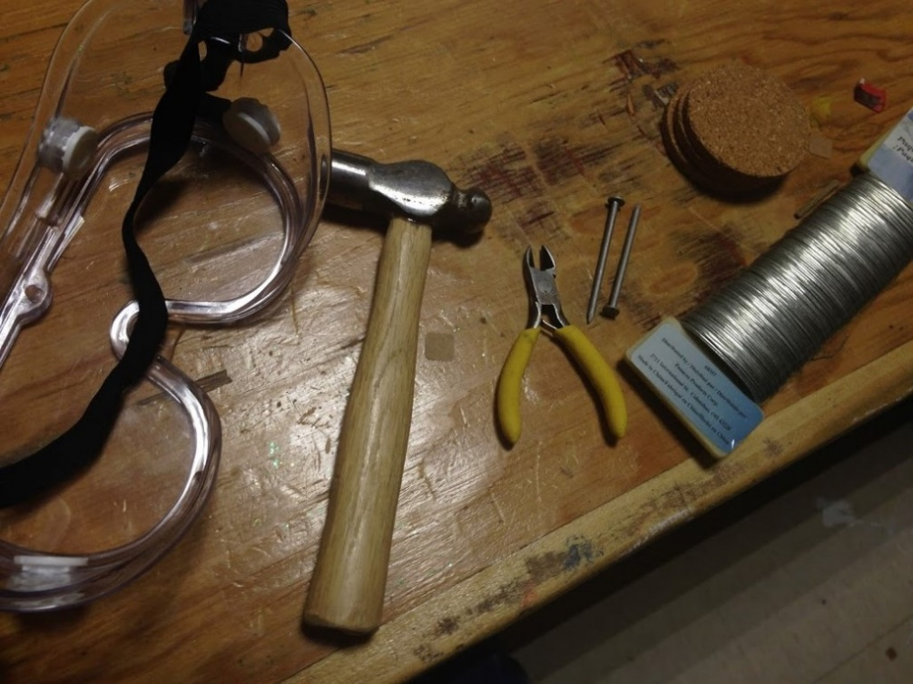
Wire Sculpture tools

Slide 3
Wire Sculpture
Tips and tricks

Slide 4
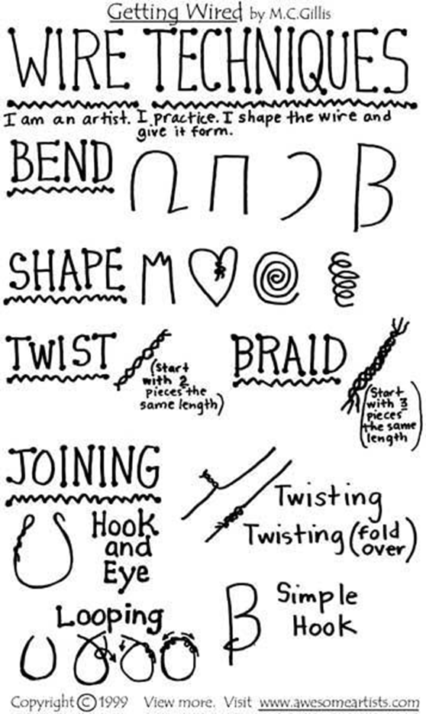
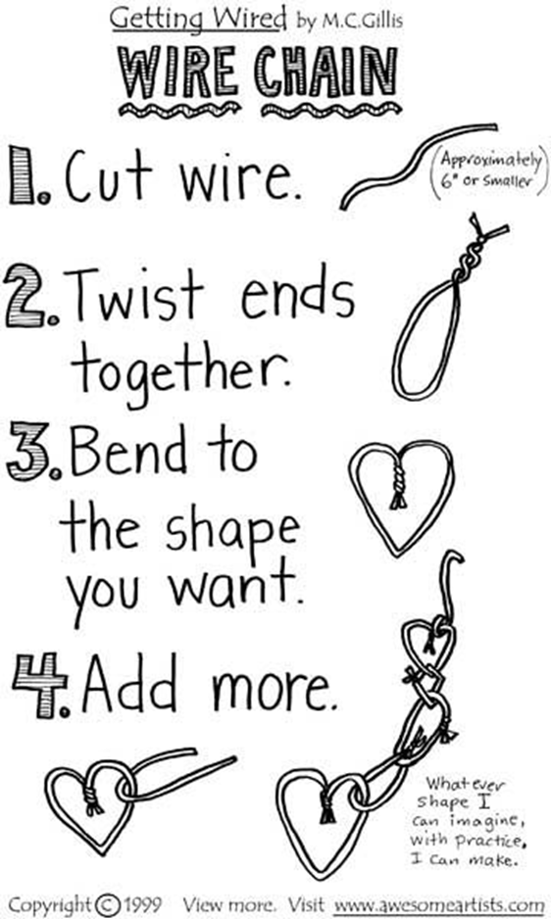

Slide 5
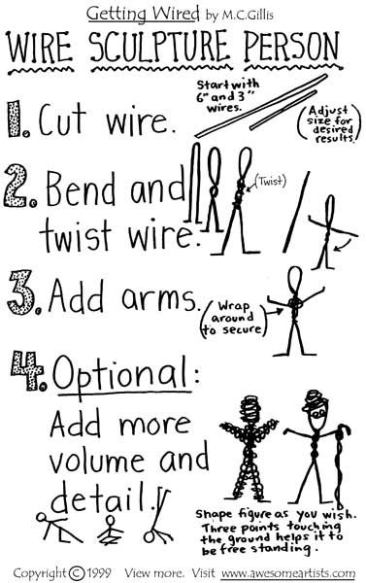
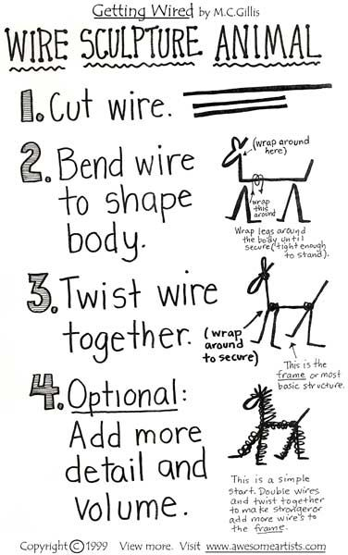

Slide 6
Properly shaped armatuer

Slide 7
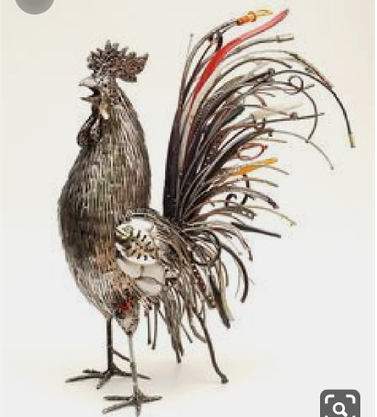
Combining two or three different gauges of wires

Slide 8
Selecting wire according to required setting

Slide 9
incorporating various materials to add more fine points to your work

Slide 10
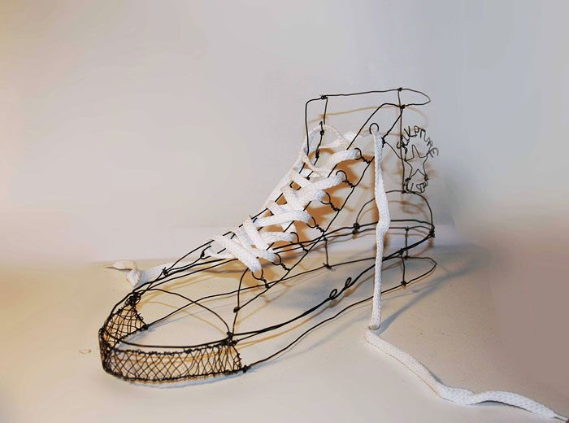
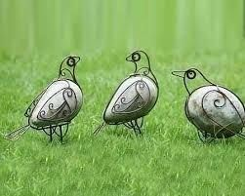
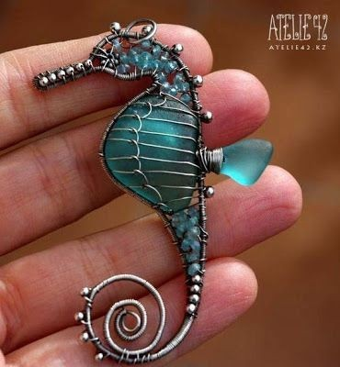
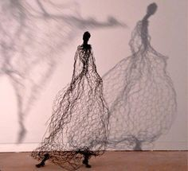

Slide 11
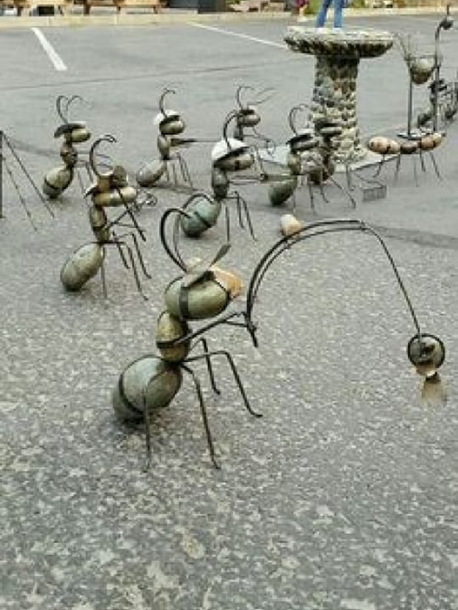

Slide 12
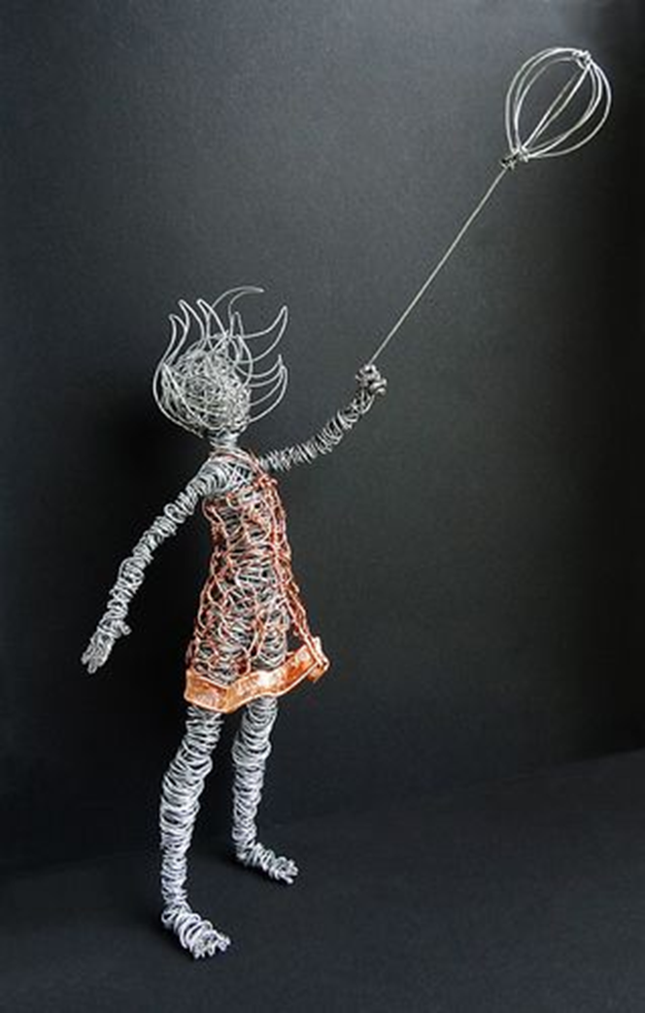
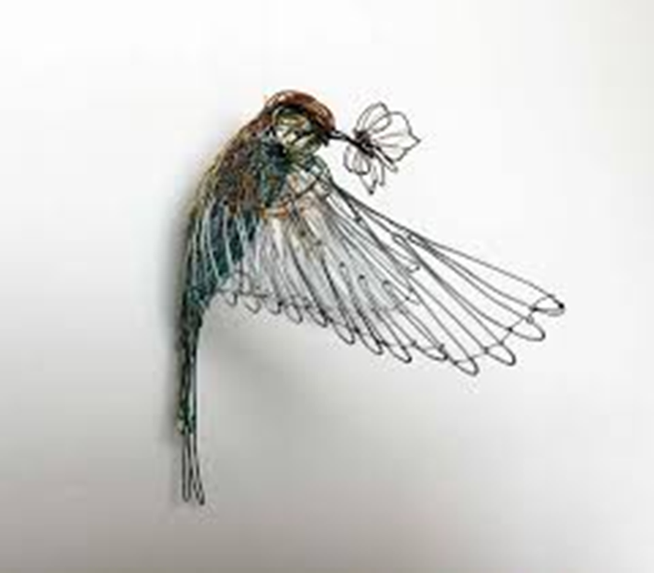
Choosing colored wires according to requirement keeping in view balance and harmony

Slide 13
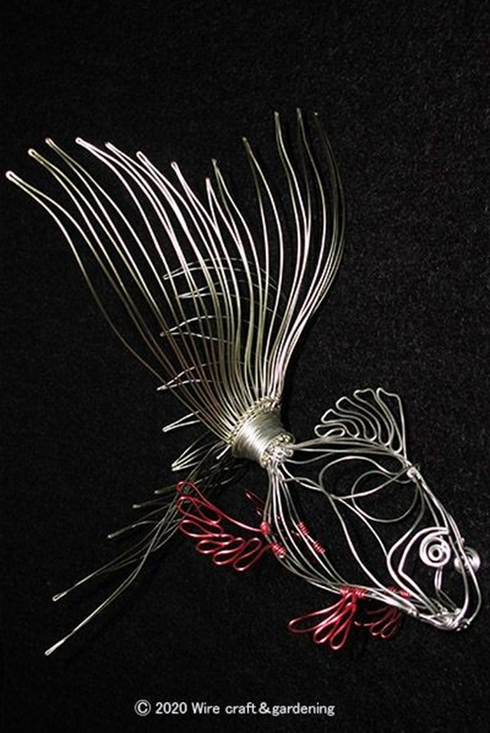
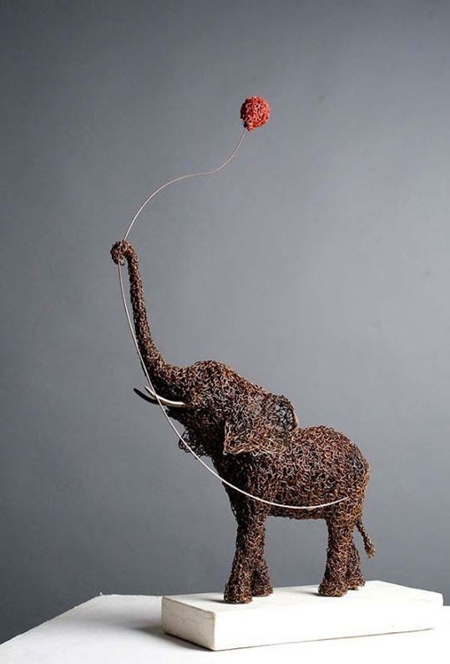
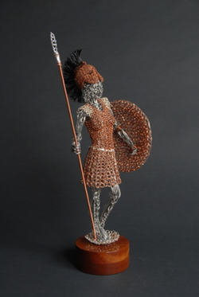

Slide 14
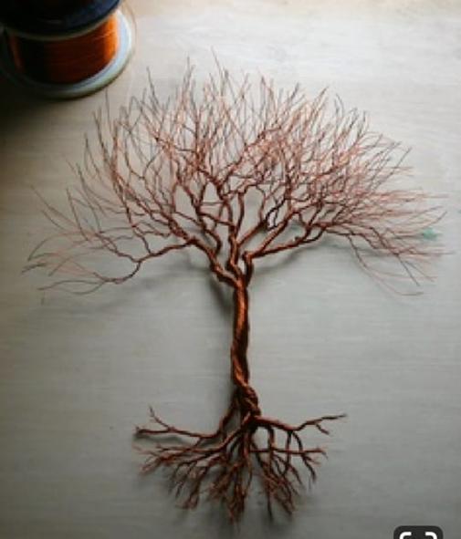
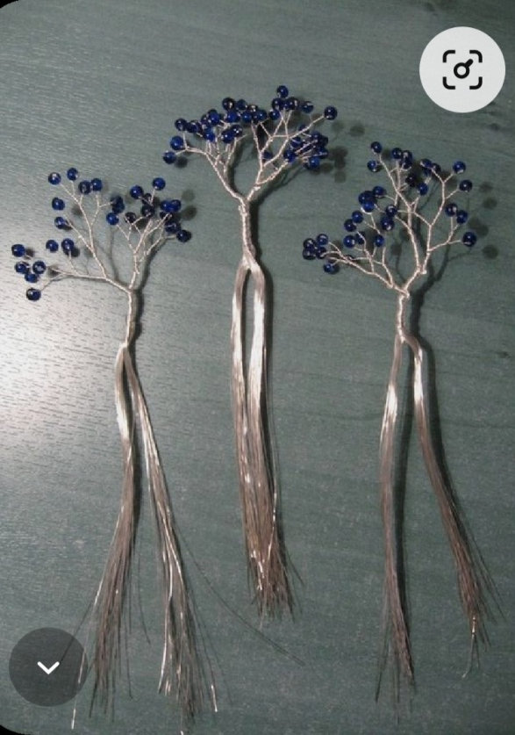
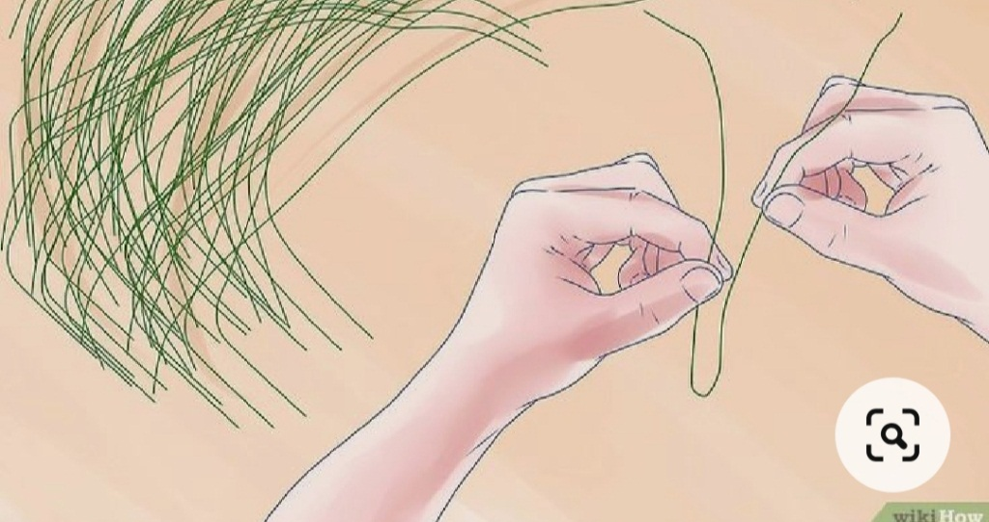
Step by step develop your sculpture

Slide 15
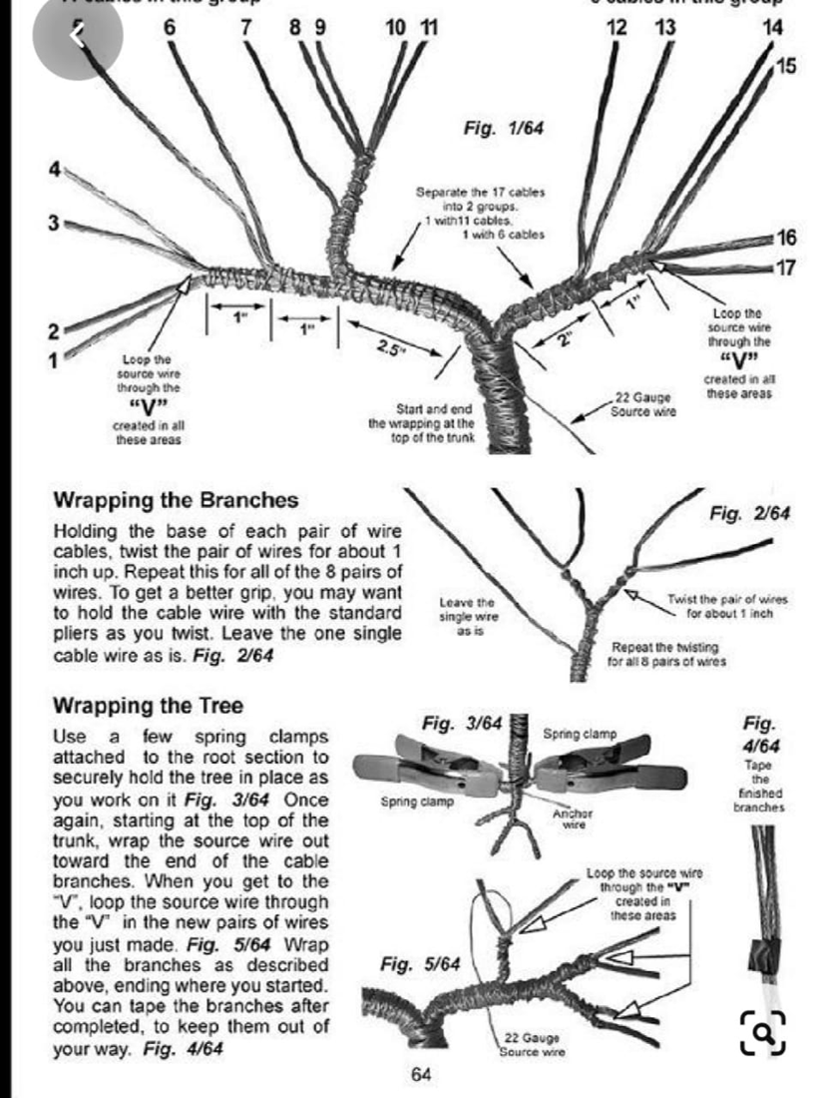

Slide 17
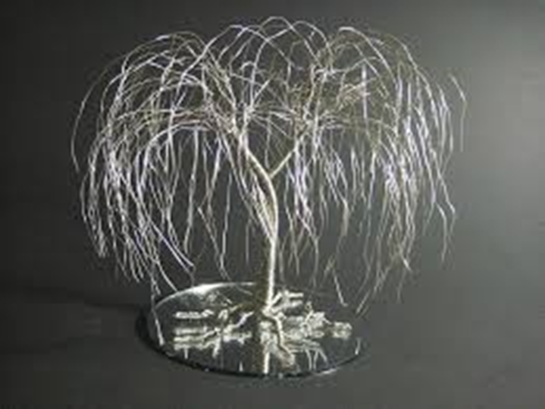
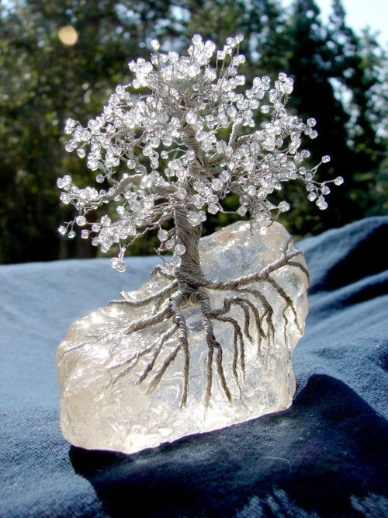
Attaining proper form

Slide 18
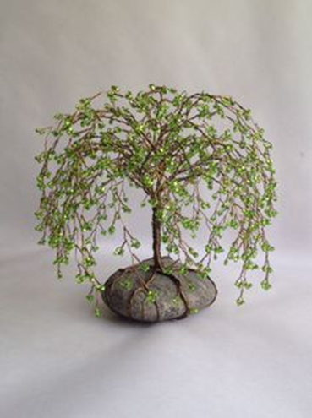
Final display

Slide 19
Click at the following link for further understanding of wire tools for sculpture
https://www.youtube.com/watch?v=kYNToke0ShU
https://www.youtube.com/watch?v=hE8ILTvayXA
https://www.youtube.com/watch?v=D5QG_vU-Ffg
https://www.youtube.com/watch?v=mtXsL5anKzg
https://www.youtube.com/watch?v=AQ9-En4n0Mc
https://www.youtube.com/watch?v=BzdYcIoPQFs
https://www.youtube.com/watch?v=4z_MxsGoEG8&list=TLPQMTQwNjIwMjD7DLTVUtffEw&index=8

Slide 20
Using various technique to convey your idea more aptly

Slide 21
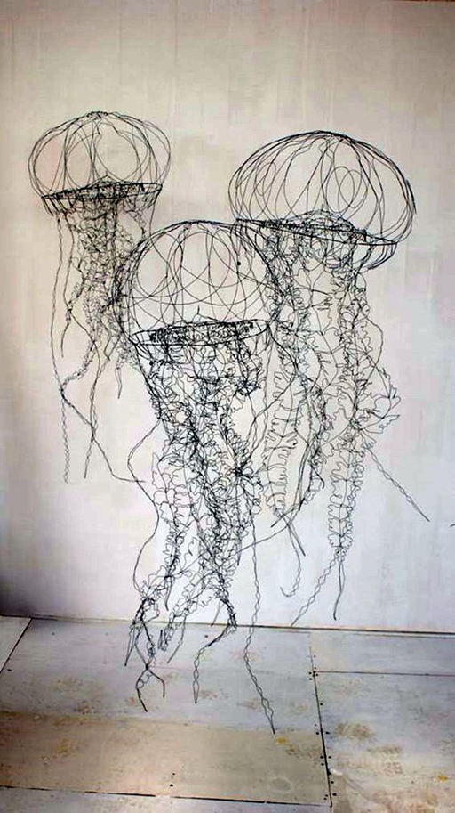
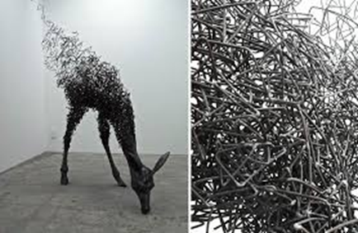

Slide 22
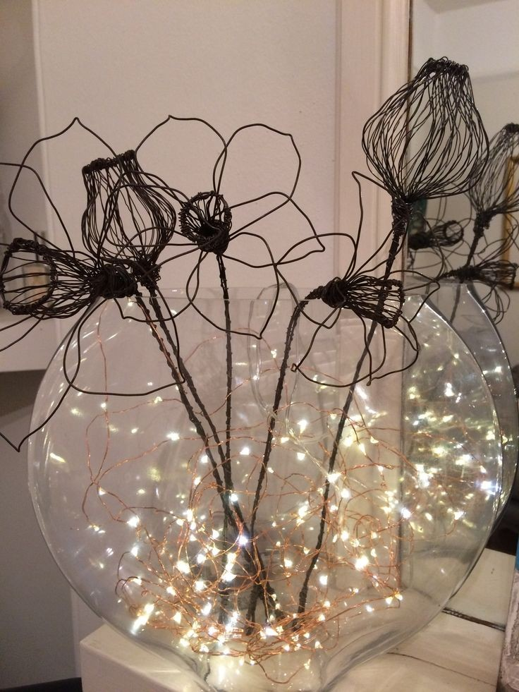
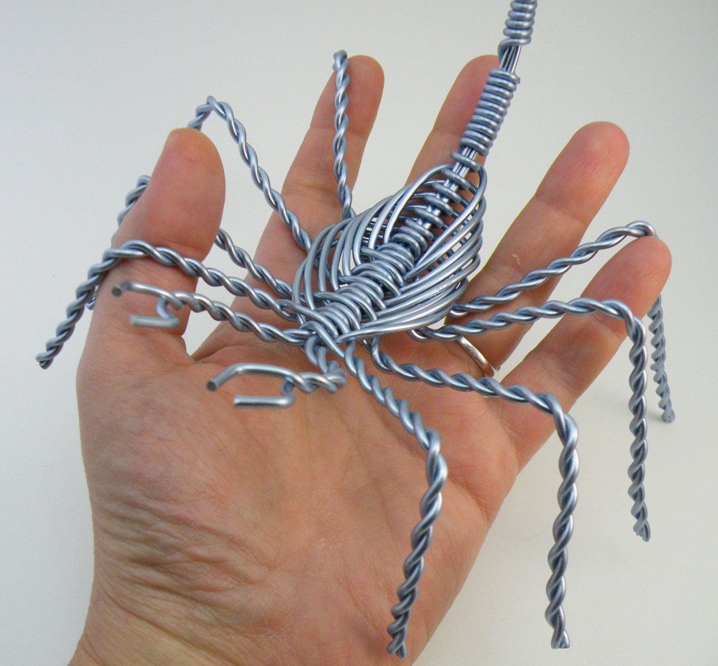

Slide 23
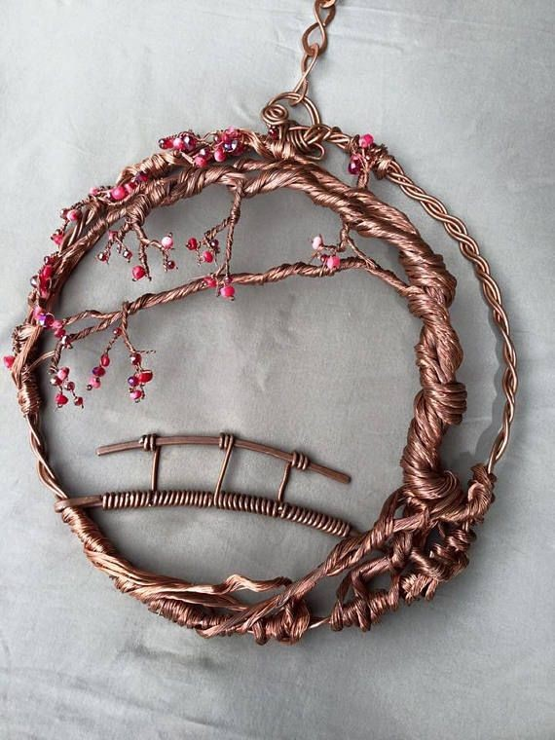
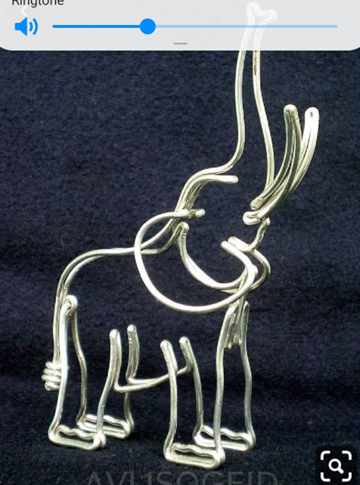
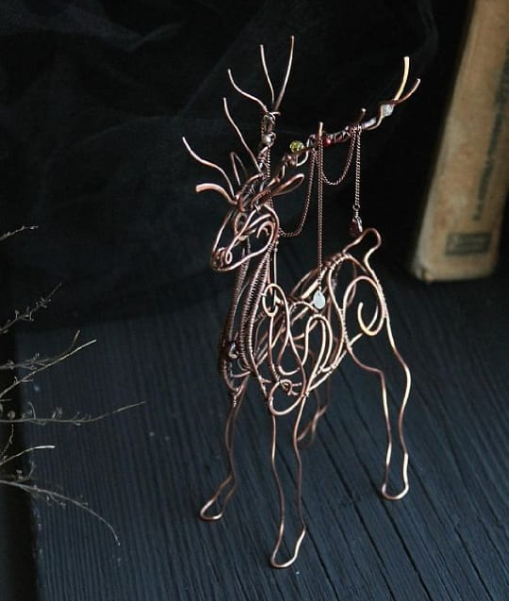
Ship-shape workmanship

Slide 24
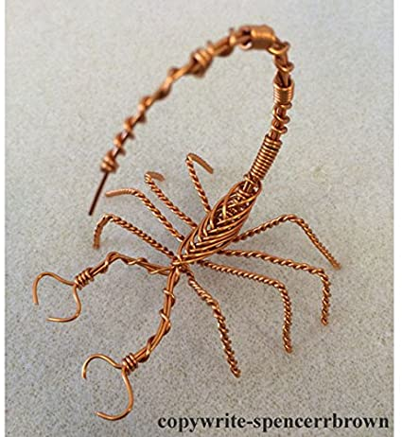
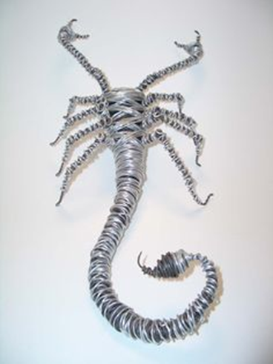

Slide 25
Resemblance in form for true depiction

Slide 26
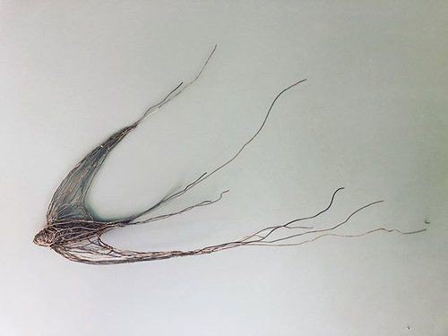
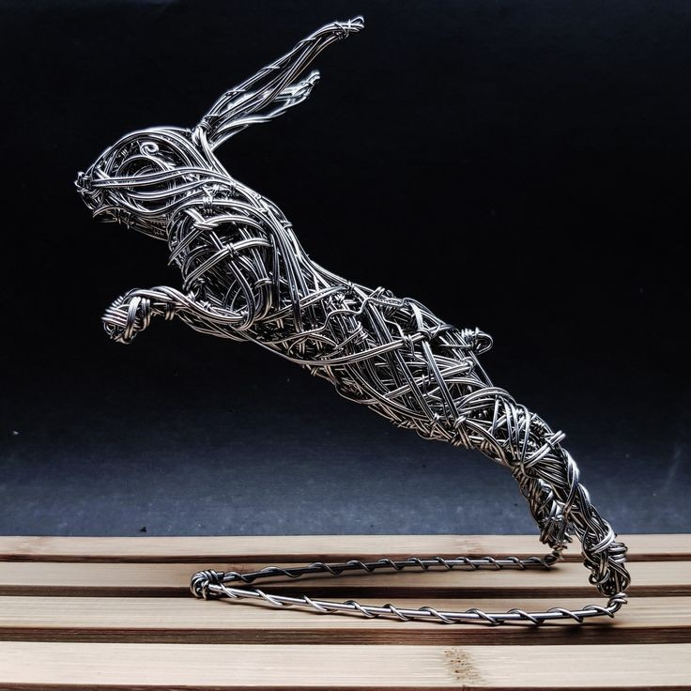
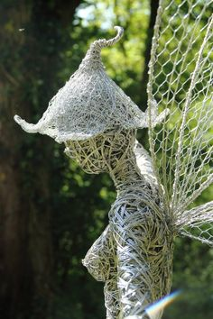

Slide 27
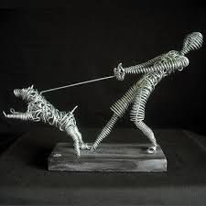

Slide 28
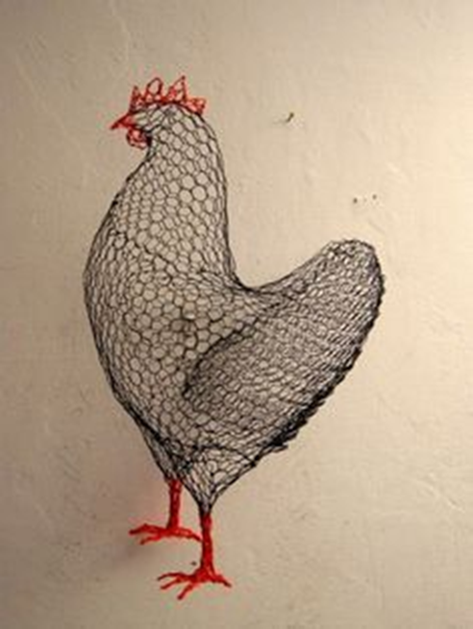
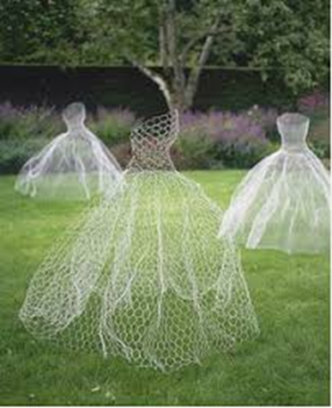
Using other wire material

Slide 29
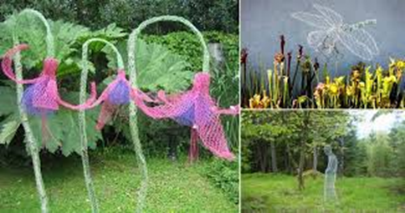
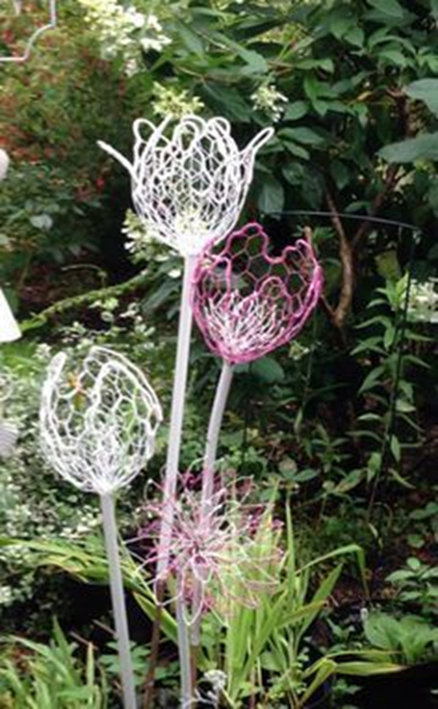

Slide 30
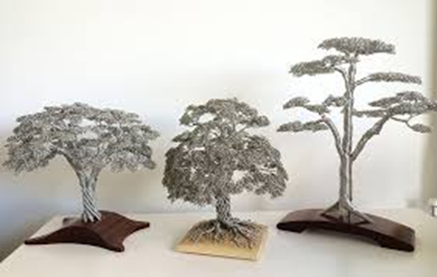
Right style of display

Slide 31
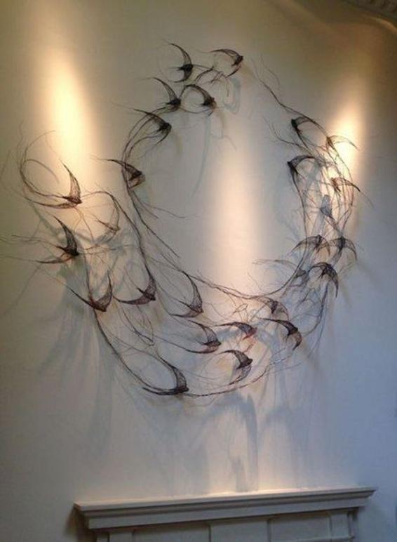
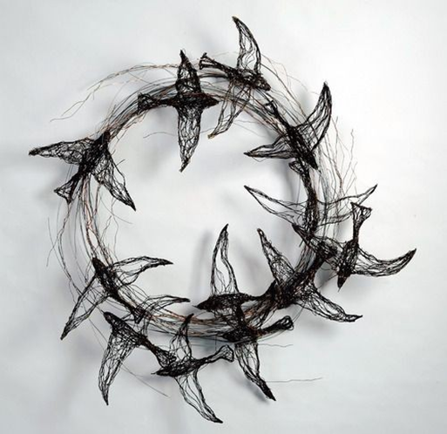

Slide 32
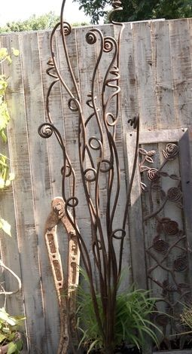
Large scale compositions or garden sculpture
https://www.youtube.com/watch?v=AcewckzBmQ0

Slide 33
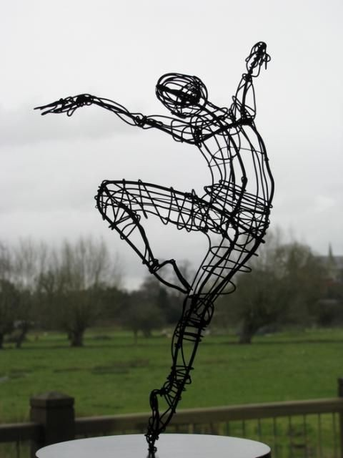

Slide 34
Assignment task
Make a wire sculpture piece of minimum size 10 ×10 inches and Make its initial sketch on paper first then get it approved by your teacher .
Size may vary as per requirement of the design.

